Slide 1
Automated Assessment and Gameplay Adaptation in Serious Educational Games
Submitted by
Bharathi Balasubramaniam
Supervising Professor: Dr. Kendra Cooper, Chair

Slide 2
Agenda
Introduction to the system
Motivation for the research
Problem Statement
Unique Contribution
Related Work
Solution
Assessment
Adaptation
Validation
Test harness method
SimSYS integration method
Conclusions and Future Work

Slide 3
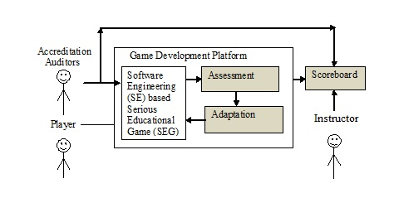
Introduction to the System
SEG - Game used as educational tool
Assessment of student’s performance in the game and game usability
Need: To assess the student’s knowledge level and usability of educational tool(game)
Adaptation of the game to suit the player
Need: To gradually improve the student’s performance without losing interest in the game

Slide 4
Motivation for the Research
Current literature in SEGs lack the following:
Completely automated Assessment and Adaptation system.
Assessment of concept wise performance.
Adaptation based on individual student’s performance.
Adaptation at the correct frequency.
Re-usable Assessment-Adaptation system.

Slide 5
Problem Statement
Characteristics of Assessment-Adaptation system for SEGs:
Rigorous
Specific
Accuracy
Correct granularity
Configurable
Dynamic
Re-usable
→ Support concept level and overall evaluation
Adaptation based on individual student’s performance
and not based on the group’s performance
Both question difficulty and game level should be adapted
→ Adaptation frequency should not be too high or low
Configurable parameters: assessment rules, adaptation rules
→ System with good response time performance
→ System re-used in other similar games

Slide 6
Unique Contribution
The proposed solution has the following characteristics:
Re-usable in any quiz based single player SEG (Aspect oriented paradigm).
Completely automated solution.
Assessment
- based on both overall and individual concept level performance
Adaptation
- based on individual student’s performance
- done at the correct frequency
A programming paradigm which aims to increase modularity by allowing the separation of cross-cutting concerns.
AspectJ concepts – pointcuts, advice, etc

Slide 7
Related Work
A vast amount of research has been done about the related work existing in current literature in general educational field, e-learning domain and electronic games.
Since electronic games are the closely related work, they are discussed in the future slides.
The literature in assessment-adaptation systems has not included performance cost. So, performance cost is approximated by considering other systems where the same algorithms are used.

Slide 8
Related Work contd..
Type of Algorithm | Adaptation Accuracy | Validation | Approximated Performance cost
Genetic algorithm | The agreement between the subjects’ visual preferences and the ﬁtness deﬁnition is stronger for simpler tracks and when more experienced players are considered. | A preliminary validation was performed on human subjects. Two surveys were designed: one focused on the visual properties of evolved tracks, and one focused on the actual playing experience. | During building block mixing, both population size and time to convergence grow linearly with the problem length, giving an overall quadratic time complexity in terms of fitness function evaluations.
Stochastic algorithm | Preserves the qualitative features of probabilistic choice and sluggish adaptation. | Extensive simulation | Stochastic/Randomized Algorithms(Las Vegas algorithm ) has average case complexity of O(nlogn) and worst case complexity of O(n²)
Loiacono, D.; Cardamone, L.; Lanzi, P.L., “Automatic Track Generation for High-End Racing Games Using Evolutionary Computation”, IEEE Transactions on Computational Intelligence and AI in Games Sept. 2011, vol.3, no.3, pp. 245-59
Cominetti, R.; Melo, E.; Sorin, S.,”A payoff-based learning procedure and its application to traffic games”, Games & Economic Behavior; Sep2010, Vol. 70 Issue 1, p71-83, 13p

Slide 9
Related Work contd..
Type of Algorithm | Adaptation Accuracy | Validation | Approximated Performance cost
Machine learning algorithms (Online learning algorithm) | With small sample sizes, it is less accurate and standard deviation is more likely to fluctuate. | A simple heart-rate monitor was attached to a variety of players, have them play the game on both settings, and then the results are mapped out. | Equal to complexity of Earliest Deadline First (EDF) algorithm. Time complexity of EDF is O(nlog₂n)
Statistical analysis | Significantly better results than old behavior. | Evaluated using simulation. | Same as average case complexity of Stochastic/ Randomized Algorithms
R. Hunicke and V. Chapman. (2004) “AI for dynamic difficulty adjustment in games”
Petersen, K.; Stoll, G.; von Stryk, O.,”A Supporter Behavior for Soccer Playing Humanoid Robots”, RoboCup 2011, pp. 386-96, xi+431 pp

Slide 10
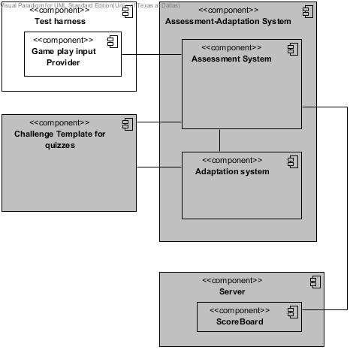
Solution
Organized as different levels and each game level consists of concepts and each concept is made up of questions of different difficulty

Slide 11
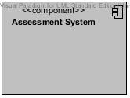
Assessment
Statistical analysis of game play data
Quiz assessment
-assessment of a single answer by assigning weights to game play data
Concept assessment (For concept level evaluation)
-assessment of a concept based on quiz assessment results
Level assessment (For goal level evaluation)
- assessment of a game level based on quiz assessment results

Slide 12
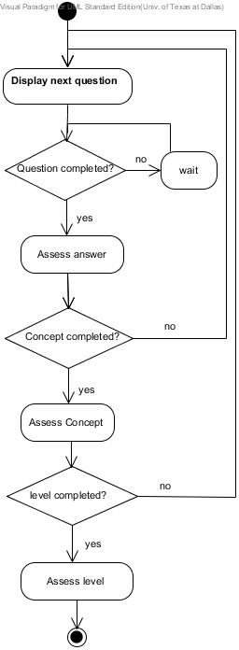
Assessment (Activity diagram)

Slide 13
Assessment Input
Observed parameters
The option selected by the player.
Time taken to answer each question in seconds.
Numbers of times options were changed before submitting each answer.
Calculated parameters
Total number of correct answers.
Total number of moderate answers.
Average time taken.
Average number of times each answer was changed before submitting.

Slide 14
Score Calculation
The four calculated parameters are given weight of a,b,c and d where a+b+d = 100 and c < d.
The weight given for ‘Average time taken’ is ‘a’
IF avgTime < minTime
score = a
ENDIF
IF avgTime >= minTime AND <=maxTime
score = a- a/3
ENDIF
IF avgTime > maxTime
score = a-2a/3
ENDIF
The weight given for ‘Average number of times answer was changed before submitting’ is ‘b’
IF avgChangeCnt < minChangeCnt
score = b
ENDIF
IF avgChangeCnt >= minChangeCnt and avgChangeCnt <=maxChangeCnt
score = b- b/3
ENDIF
IF avgChangeCnt > maxChangeCnt
score = b-2b/3
ENDIF
The weight given for ‘Total number of moderate answers’ is ‘c’
(moderateAnsCnt/noOfQns)*c
The weight given for ‘Total number of correct answers’ is ‘d’
(correctAnsCnt/noOfQns)* d

Slide 15
Implementation
Quiz Assessment:
if(q.selectedAnswer == q.correctAnswer){ //If selected answer is correct
c.correctAnswerCount ++;
l.correctAnswerCount ++;
}else if(q.selectedAnswer == q.moderateAnswer){//If selected answer is moderate
c.moderateAnswerCount ++;
l.moderateAnswerCount ++;
}else{
c.wrongAnswerCount ++;
l.wrongAnswerCount ++;
}
Concept Assessment:
/*Assign marks based on average time spent on the concept*/
if(c.avgTimeSpent <20){
c.marks += 10;
}else if(c.avgTimeSpent >=20 && c.avgTimeSpent <=40){
c.marks += 6;
}else if(c.avgTimeSpent >40 && c.avgTimeSpent <=60){
c.marks += 2;
}
/*Assign marks based on average number of times options are changed on the concept*/
if(c.avgOptionsChangeCount == 0){
c.marks += 10;
}else if(c.avgOptionsChangeCount == 1){
c.marks += 6;
}else if(c.avgOptionsChangeCount == 2){
c.marks += 2;
}
/*Assign marks based on the number of moderate answers*/
c.marks += (c.moderateAnswerCount * 35 ) / c.noOfQns
/*Assign marks based on the number of moderate answers*/
c.marks += (c.correctAnswerCount * 80 ) / c.noOfQns;
Level Assessment:
Level assessment is calculated using the calculated parameters of a game level, similar to concept assessment.

Slide 16

Adaptation
Based on scores calculated in Assessment
-grade calculation based on minimum threshold and maximum threshold
Difficulty adaptation
-concept’s difficulty adaptation based on concept level grades
Level adaptation
- game level adaptation based on whether the student passed/failed a particular game level
- student can pass a game level only if both concept level and goal level performance are above average
Score above which performance is considered ‘good’
Score below which performance is considered ‘bad’

Slide 17
Grade calculation
Concept level grade and Goal level grade
IF score > maxThreshold
Grade = A
ENDIF
IF score >= minThreshold AND score <= maxThreshold
Grade = B
ENDIF
IF score < maxThreshold
Grade = C
ENDIF
Final grade
Minimum of all the concept level and goal level grades.

Slide 18
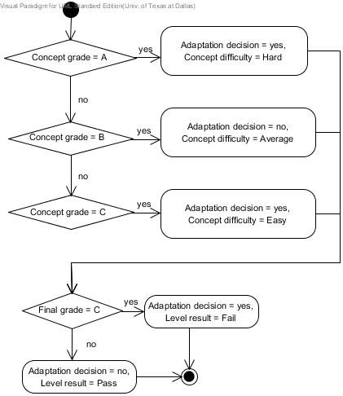
Adaptation (Activity Diagram)

Slide 19
Implementation
Concept level grade
//Assign concept level grade based on the player's concept level performance
if(c.marks > 50 ){//If the player's concept level score is good
c.grade = 'A';
}else if(c.marks>= 30 && c.marks <= 50 ){//If the player's concept level score is average
c.grade = 'B';
}else{//If the player's concept level score is bad
c.grade = 'C';
}
Goal level grade
//Assign goal level grade based on the player's overall performance
if(l.marks < 50){ //If the player's goal level score is bad
l.grade = 'C';
}else if (l.marks >= 50 && l.marks <= 70){ //If the player's goal level score is average
l.grade = 'B';
}else{ //If the player's goal level score is good
l.grade = 'A';
}

Slide 20
Implementation
Final grade
/*Checking if the player’s performance is bad or average in any of the concepts*/
for(int j=0; j<l[i].noOfConcepts; j++){
if(c[j].marks>= 30 && c[j].marks <= 50 ){
l[i].avgFlag = 1;
}else if (c[j].marks < 30){
l[i].badFlag = 1;
}
}
/*Assign final grade based on the player's performance in every concept and goal level*/
if(l.badFlag == 1 || l.grade == 'C'){
l.finalGrade = 'C';
}else if (l.avgFlag == 1 || l.grade =='B'){
l.finalGrade = 'B';
}else{
l.finalGrade = 'A';
}

Slide 21
Implementation
Difficulty Adaptation
/*Adaptation decision for the difficulty of the concept based on the player's performance of the same concept in the current level(good or avg or bad)*/
if(c.grade ==‘A’){
c.difficulty = 2;
}else if(c.grade == ‘B’){
c.difficulty = 1;
}else{
c.difficulty = 0;
}
Level Adaptation
/*Decide whether the player passed this level based on the player's final grade*/
if (l.finalGrade =='A'){
l.nextLevel ++; //passed this level
}else if (l.finalGrade =='B'){
l.nextLevel ++; //passed this level
}

Slide 22
Validation
Tested using a test-harness.
- used mutation based input generation to replicate the performance of 100 students.
-sensitivity analysis on input data.
Integrated into the SimSYS Game Development Platform.

Slide 23
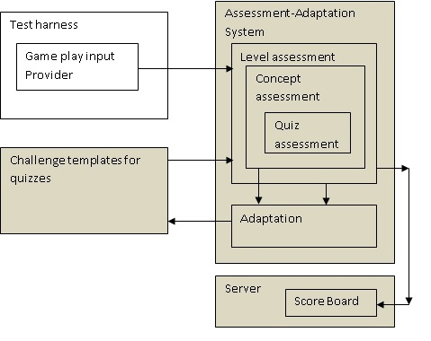
Test harness method

Slide 24
Mutation based input generation
Splitting the set of students for different performance
badMarker = (noOfStudents * 25)/100; //1/4 of students have bad performance
avgMarker = (noOfStudents * 75)/100; //1/2 of students have average performance
//No. of students above average marker are the number of good students.
Generating bad performance
if(p <= badMarker){ //If the student falls within the bad range
studentFlag = "bad";
selectedAns = generator.nextInt(4) + 1; //Generate a random number from 1 to 4.
correctAns = generator.nextInt(4) + 1; //Generate a random number from 1 to 4.
moderateAns = 5 - correctAns; //Correct and moderate answer cannot be same.
//Moderate answer will also be from 1 to 4.
optionsChangeCnt = generator.nextInt(6); //Generate a random number from 0 to 5.
timeSpent += timeSpent + 65; //Timespent is initialized to 500. Spend a lot of time.
}

Slide 25
Mutation based input generation
Generating average performance
else if((p> badMarker) && (p <= avgMarker)){ //If the student falls within the avg range
studentFlag = "avg";
selectedAns = generator.nextInt(4) + 1; //Generate a random number from 1 to 4.
//Try to make selected answer, correct
if(selectedAns < 3){
correctAns = selectedAns + generator.nextInt(3);
}else{
correctAns = selectedAns - generator.nextInt(3);
}
//Make the selected answer either correct or moderate
if(selectedAns == correctAns){
moderateAns = 5 - correctAns; //Correct and moderate answer cannot be same.
//Moderate answer will from 1 to 4.
}else{
moderateAns = selectedAns;
}
optionsChangeCnt = generator.nextInt(4); //average options change count
timeSpent += timeSpent + 45; // Timespent is initialized to 500.
//Spend more time than good student
}

Slide 26
Mutation based input generation
Generating good performance
else if (p > avgMarker){ //If the student falls within the good range
studentFlag = "good";
selectedAns = generator.nextInt(3) + 1; //Will generate a random number from 1 to 4.
//Try to make selected answer, correct
if(selectedAns < 3){
moderateAns = selectedAns + generator.nextInt(3);
}else{
moderateAns = selectedAns - generator.nextInt(3);
}
//Make the selected answer either moderate or correct
if(selectedAns == moderateAns){
correctAns = 5 - moderateAns; //Correct and moderate answer cannot be same.
//Moderate answer will from 1 to 4.
}else{
correctAns = selectedAns;
}
optionsChangeCnt = generator.nextInt(2);
}

Slide 27
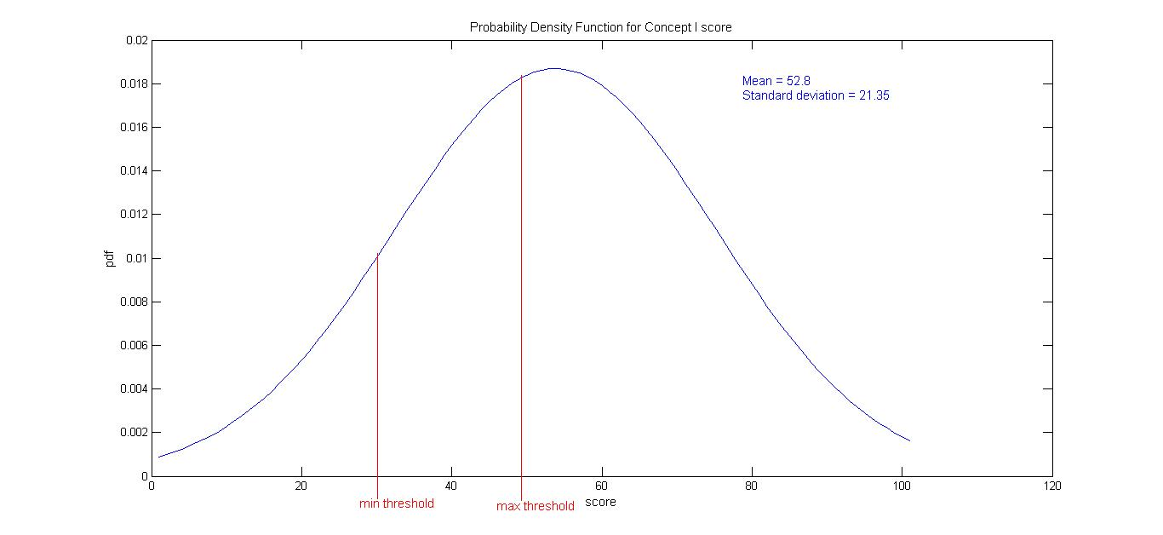
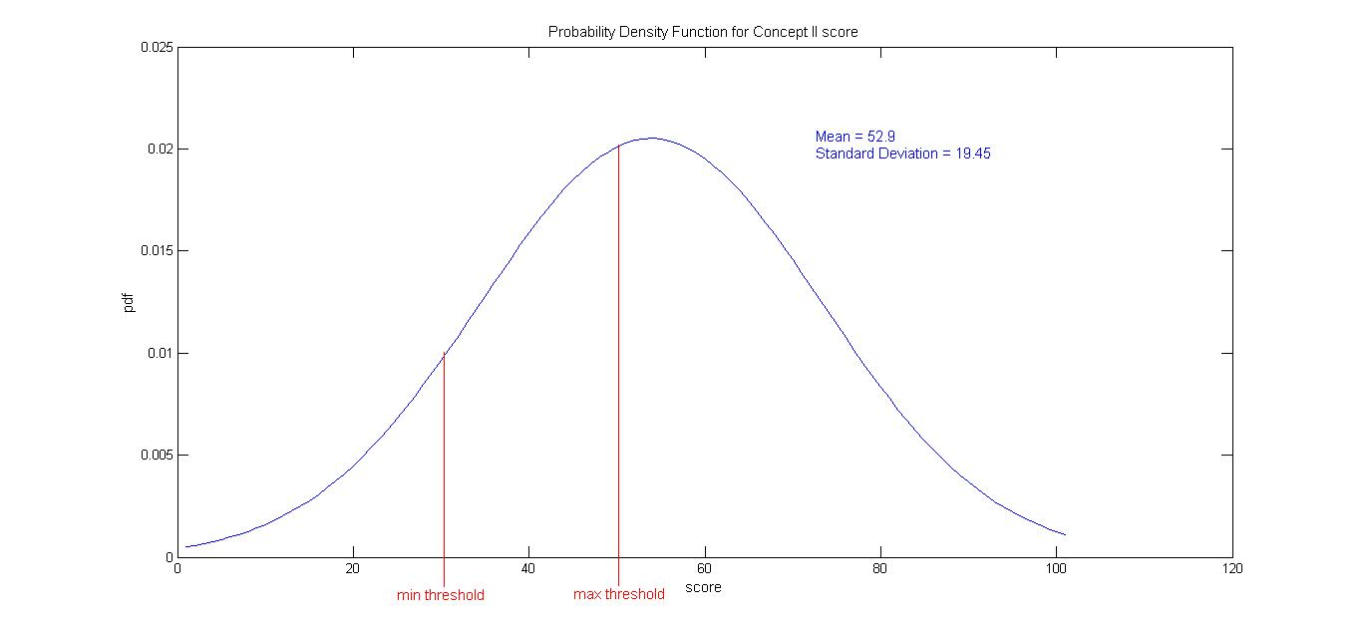
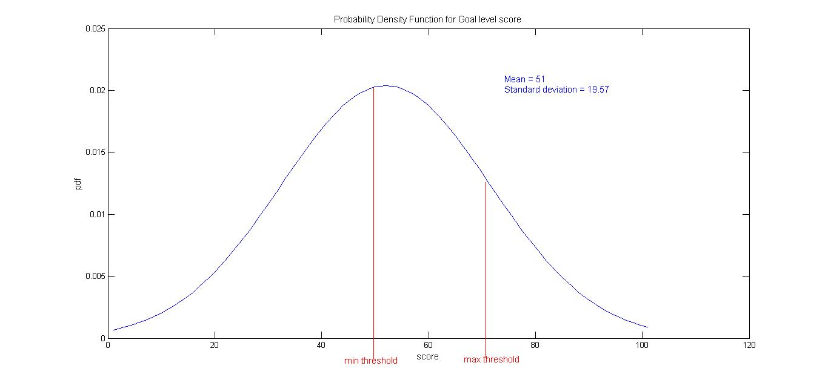
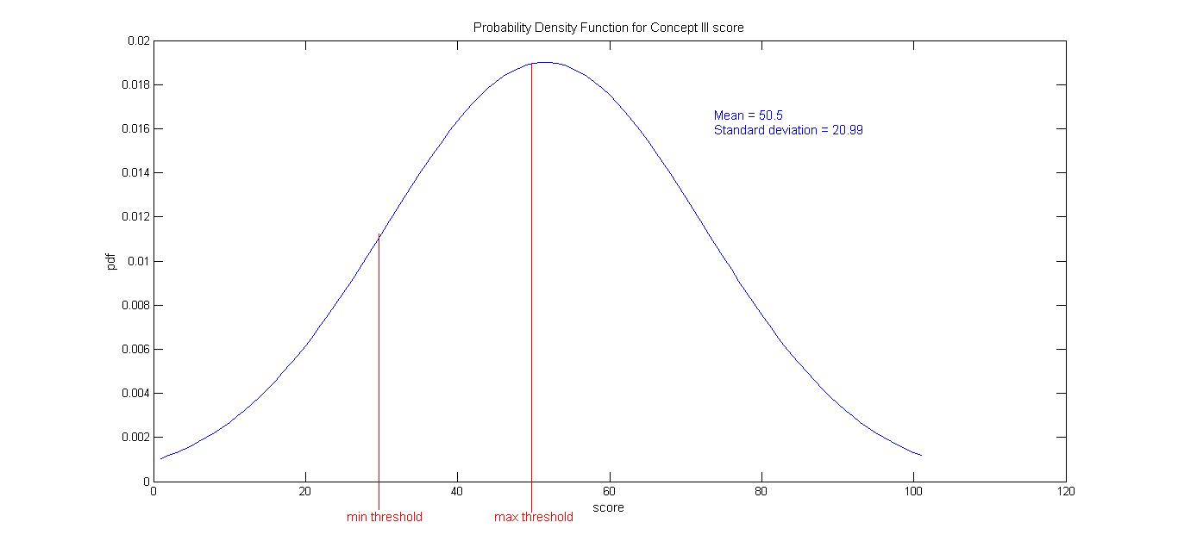
Results
Concept I Score(Input) | Number of students | Grade | Adaptation Decision(Output)
0-10 | 0 | C | Yes- to lower difficulty
11-20 | 4 | C | Yes- to lower difficulty
21-30 | 12 | C | Yes- to lower difficulty
31-40 | 8 | B | No
41-50 | 8 | B | No
51-60 | 26 | A | Yes- to higher difficulty
61-70 | 17 | A | Yes- to higher difficulty
71-80 | 7 | A | Yes- to higher difficulty
81-90 | 12 | A | Yes- to higher difficulty
91-100 | 6 | A | Yes- to higher difficulty
Concept III Score(Input) | Number of students | Grade | Adaptation Decision(Output)
0-10 | 0 | C | Yes- to lower difficulty
11-20 | 4 | C | Yes- to lower difficulty
21-30 | 14 | C | Yes- to lower difficulty
31-40 | 4 | B | No
41-50 | 14 | B | No
51-60 | 28 | A | Yes- to higher difficulty
61-70 | 12 | A | Yes- to higher difficulty
71-80 | 7 | A | Yes- to higher difficulty
81-90 | 12 | A | Yes- to higher difficulty
91-100 | 5 | A | Yes- to higher difficulty
Goal level Score(Input) | Number of students | Grade | Adaptation Decision(Output)
0-10 | 0 | C | Repeat level
11-20 | 0 | C | Repeat level
21-30 | 13 | C | Repeat level
31-40 | 13 | C | Repeat level
41-50 | 3 | C | Repeat level
51-60 | 39 | B
61-70 | 8 | B
71-80 | 2 | A
81-90 | 21 | A
91-100 | 1 | A
Concept II Score(Input) | Number of students | Grade | Adaptation Decision(Output)
0-10 | 0 | C | Yes- to lower difficulty
11-20 | 2 | C | Yes- to lower difficulty
21-30 | 9 | C | Yes- to lower difficulty
31-40 | 10 | B | No
41-50 | 10 | B | No
51-60 | 28 | A | Yes- to higher difficulty
61-70 | 17 | A | Yes- to higher difficulty
71-80 | 8 | A | Yes- to higher difficulty
81-90 | 12 | A | Yes- to higher difficulty
91-100 | 4 | A | Yes- to higher difficulty

Slide 28
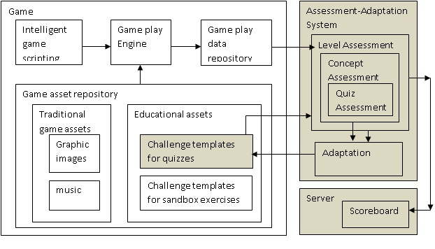
SimSYS Integration method

Slide 29
Results
XML for the quizzes:
<Level id=1>
<concept name="Design">
<difficulty name="average">
<question id=1> What does a design specification describe?</question>
<correct_answer> A specification of how the software will be
implemented</correct_answer>
<moderate_answer>
<text>A specification of the GUI</text>
<right_answer>It is because the design specification can include the
GUI specification</right_answer>
<wrong_answer> It is because the GUI specification is always the
most important part of a design specification</wrong_answer>
</moderate_answer>
<incorrect_answer> A specification of what will be implemented
</incorrect_answer>
</difficulty>
</concept >
</Level >
When a student’s performance is average in the ‘Design’ concept in level 0, the above question is selected. So, the difficulty of this concept is not adapted.

Slide 30
Conclusions
Accomplishments:
Rigorous
Specific
Accuracy
Correct granularity
Re-usable
Limitations:
Partially configurable
Not dynamic
Re-usable only in java based games
Not tested for scalability
→ Support concept level and overall evaluation
Adaptation based on individual student’s performance
Both question difficulty and game level are adapted
→ Adaptation at the end of every level
→ Because of Aspect Oriented Paradigm
→ Parameterized but not completely configurable (Partially accomplished)
→ Adaptation is not done on the fly

Slide 31
Future Work
Completely integrating the system with SimSYS game for its assessment and adaptation.
Validation of the system rigorously with other open source games available online.
Extending the proposed assessment adaptation approach for other forms of games like graphic objects based SEGs and multiplayer SEGs can be done in the future.

Slide 32

Questions??

